Slide 1

Downview Primary School
Year 5
2026 - 2027

Slide 2
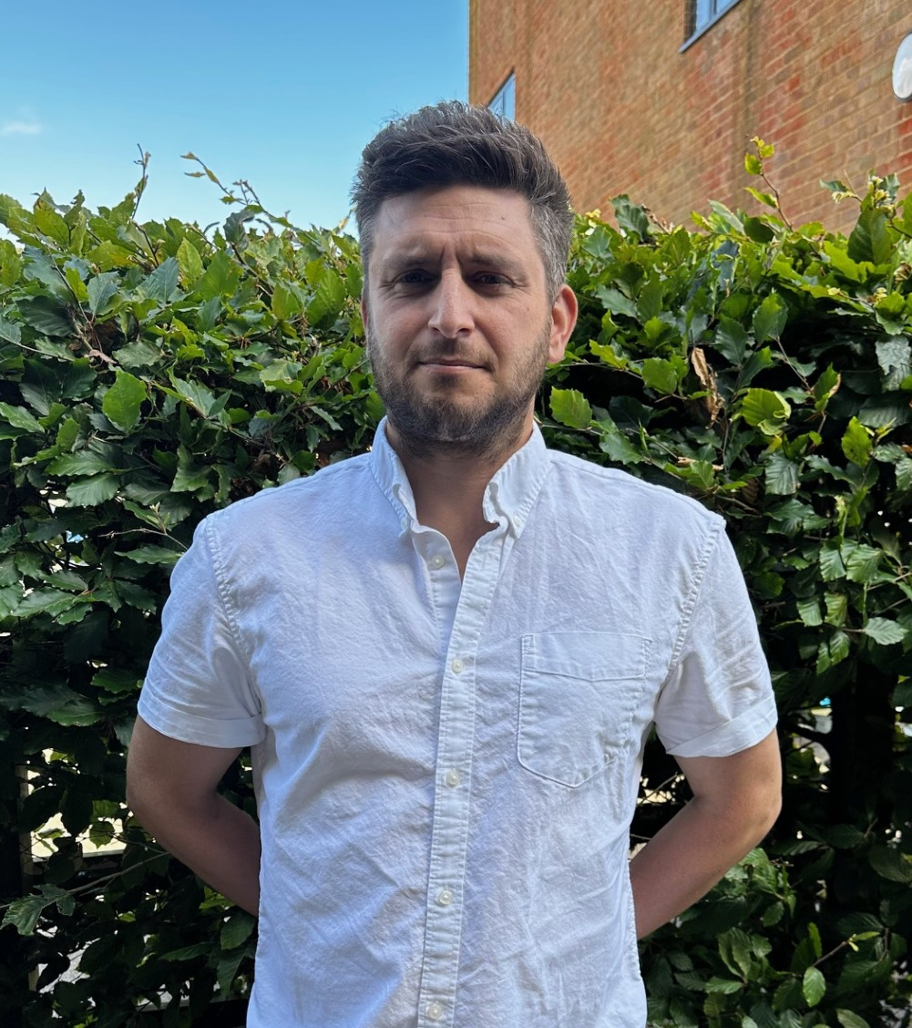
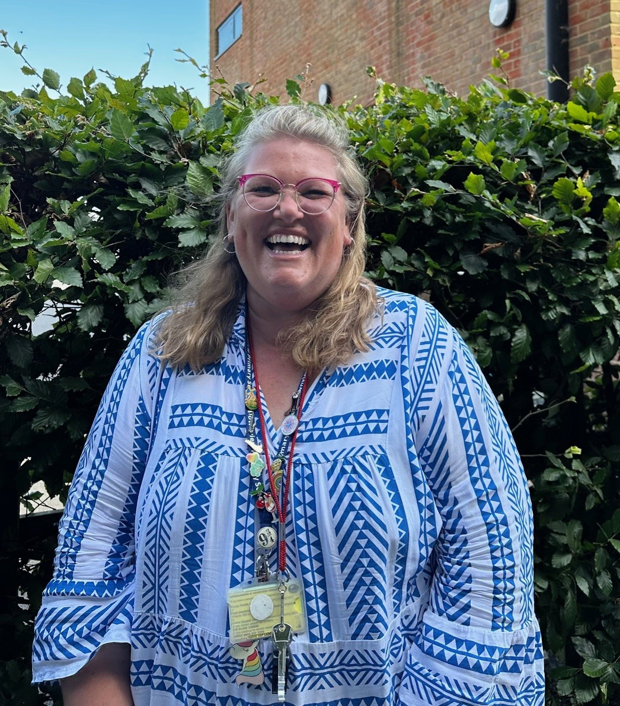
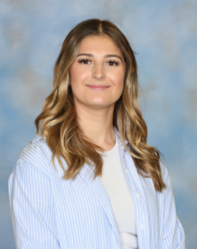
The Year 5 team:
Redwood: Mr Norris
Sycamore: Mrs Gapper
Maple: Miss Warrington
Teaching assistants:
Miss Buckland, Miss Baker, Mrs Wells.
Contact us: Year5admin@downviewprimary.co.uk

Slide 3
The school day:
8.40 start of school – morning work (Spellings, x tables and reading/lexia)
Two morning sessions English and Maths
(separated by a 15 minute break and assembly on Wednesday and Thursday)
12.00 – 1.00 LUNCH
Mastering number lesson after lunch most days.
Science, PE and foundation subjects are often taught in the afternoon
3.20 Home time (walking home form).

Slide 4



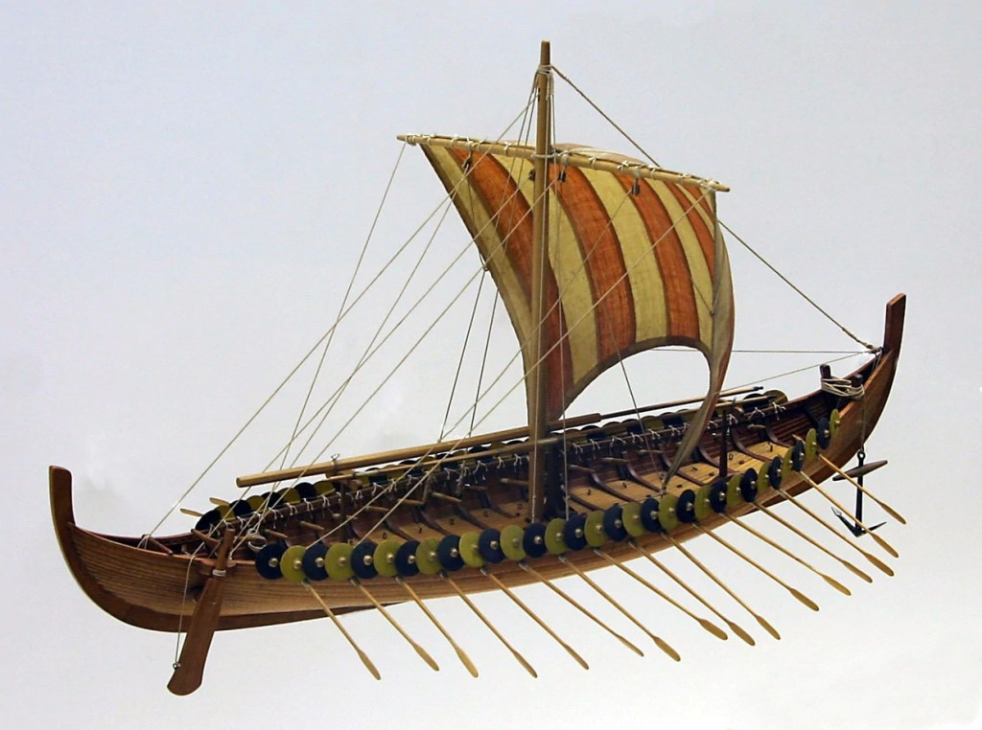
Year 5 Curriculum:
History
Anglo-saxons
Greeks
Geography
Deserts
Alps
Science
Forces
Earth & Space
Art and DT
Mixed media portraits
Oceans
Living things
Materials
Sculptures
Anglo-saxon boats
Music
Rock music (Livin’ on a prayer)
Motown
Pop music (Make you feel my love)
Hip Hop (Fresh Prince of Bel-Air theme)

Slide 5
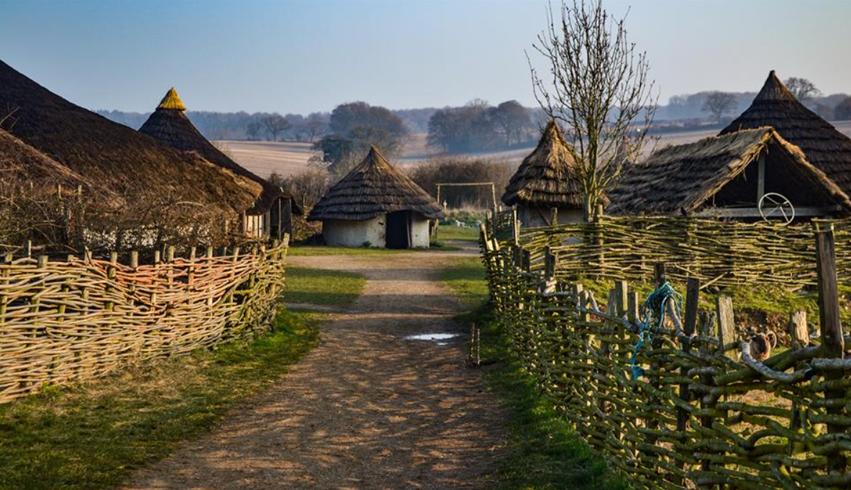
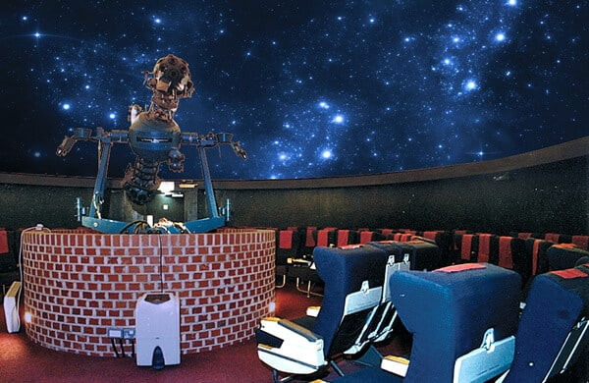
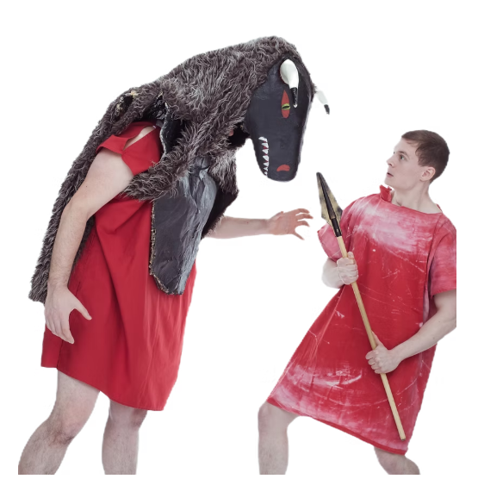
Year 5 visits and special days:
Autumn Term: Butser Ancient Farm
Tuesday 20th October
(supporting history topic – Anglo Saxons)
Autumn Term: Planetarium
Tuesday 1st December
(Supporting science topic – Earth and Space)
Summer Term: Rainbow Theatre visit & Year 5 Greek day
Tuesday 27th April
(supporting history topic – Ancient Greeks)

Slide 6
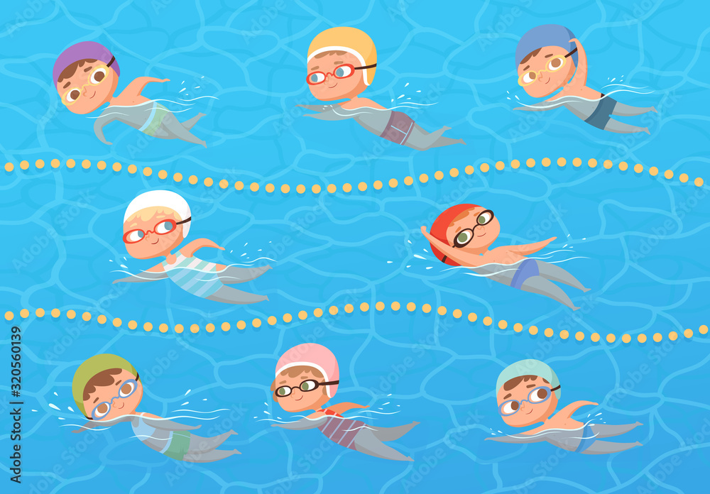
Swimming
WE START THIS FRIDAY
Friday 11th Sept – Friday 11th Dec
As the weather changes, all children must bring a warm waterproof coat.
Children should come costume ready – remember to pack underwear with a towel. Please come to school in PE kit on Fridays to help with changing afterwards.
Goggles strongly recommended.
PE days this half term:
Redwood - Monday
Maple - Tuesday
Sycamore - Wednesday
All classes - Friday (swimming).
Children come to school in PE kits please (See uniform requirement on website)
Long hair to be tied up and no jewellery to be worn

Slide 7










Year 5 English – Teaching through a text

Slide 8

Yr 5 Homework – this will usually go hand in hand with the previous week’s learning
1. Grammar task – there will be one grammar sheet to complete each week.
2. Maths homework – set on Mymaths (Children’s log ins are stuck into their reading records and homework folders)
(if you are unable to access a laptop/tablet/phone, please let us know)
3. Spelling practice – Autumn 1 we revise last year’s Yr 4 key words before moving onto Yr 5
(Children will be tested weekly - each Friday on 10 spellings they have practiced that week)
*If your child has been assigned a Lexia account – please log on at home instead of spelling practice in Autumn 1
4. Reading – aim for 3x weekly. Adults/older siblings, please sign the 100sq in the front of reading records
100 reads = Brand new book of choice from the vending machine.
Homework is set on a MONDAY and is expected back in the following Monday.
Effort is always celebrated and rewarded.

Slide 9
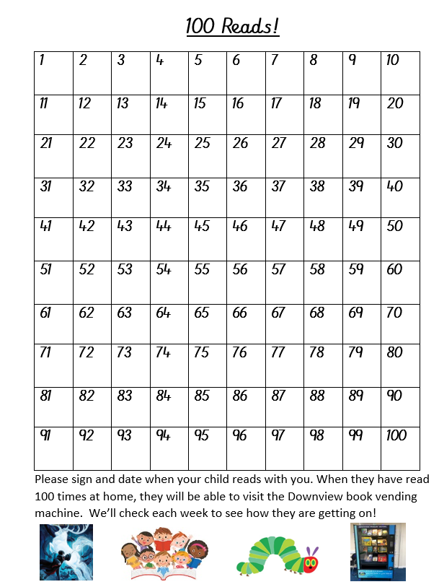
Help your child to reach 100 reads!
Please sign their 100 square every time you hear them read. If you need a pen, please ask.
We will regularly check their progress with this.

Slide 10

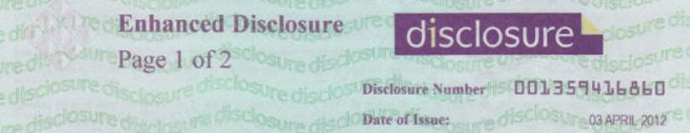
Other information
New mobile phone policy
Disclosure and barring service (DBS) for any adults working in school regularly

Slide 11















Reading at Downview
We work hard with all our children to support them to read with confidence and enjoyment, and become lifelong readers.
We need your help!

Slide 12
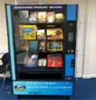
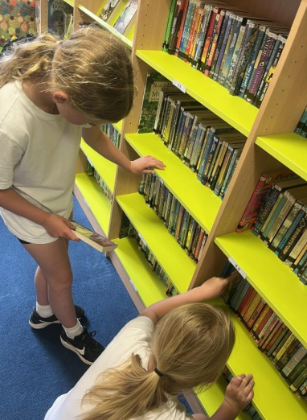
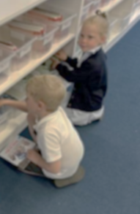
Reading at home
In Key Stage 2 encourage your child to bring their Accelerated Reader book home every day so that you can read together.
Try to read at home every day, a minimum of 3 times a week is essential for good progress. Find a quiet time, leave phones/tablets in a different room to give the book your full attention for 10-15 minutes!
Sign their 100 square when you hear them read. 100 reads at home means a trip to the vending machine to choose a new book to take home!
Make reading part of your routine. They will love it even more if use an accent, whisper or sing, have fun with the story, even if you’ve read several times before! Children love being read to from Reception to Year 6 and beyond! Hearing someone else read aloud is an important part of learning to read.

Slide 13
Other useful information:
Use ‘The Reader Teacher’ . A great place to find books your child will love to read.
https://www.thereaderteacher.com/
Visit the library in town –it’s free and you can borrow up to 20 books at a time
READ, READ, READ anything, anytime, anywhere as much as you can!
Check out our website ‘Helping your child to read at home’ for extra tips and support.

Slide 14
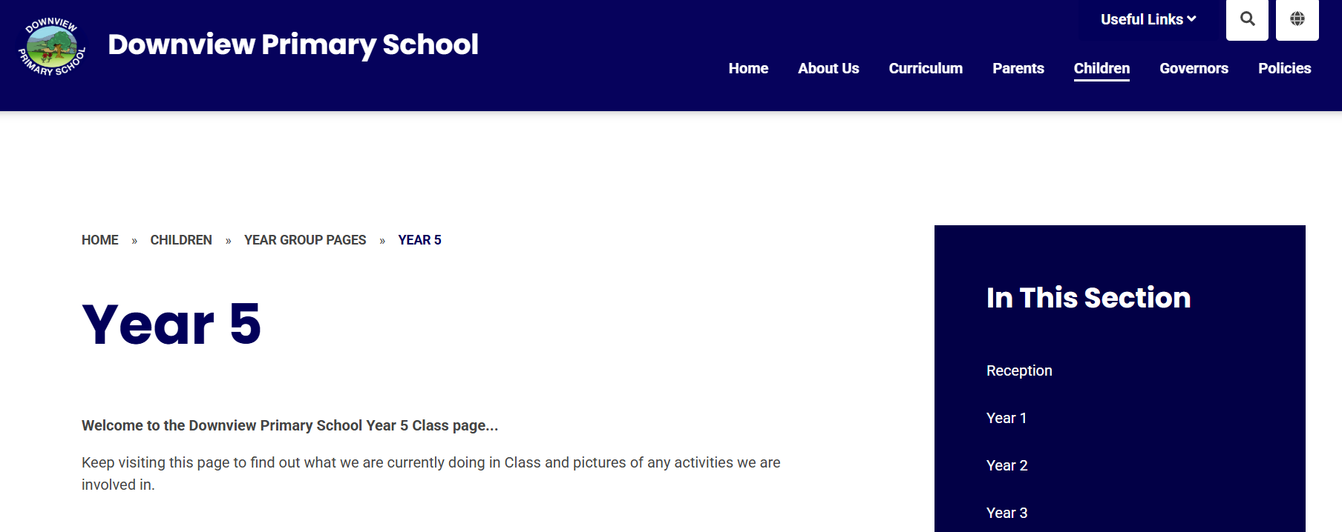
Thank you for coming – this Powerpoint will be on the Year 5 page of the school website.
https://www.downviewprimary.co.uk/year-5

