Slide 1
Downview
Primary School
Welcome to Year 3
2026-2027
Please take a seat

Slide 2
Welcome to Year 3
Meet the team….

Slide 3
Attendance and timings
 | Time | Event | What do I need to know?
AM | 8:40 | Doors open | Remember a named water bottle and reading record book daily
 | 8:50 | Session 1 | Learning starts promptly at this time
 | 10:20 | Morning Break | If you’ll be feeling peckish, bring your own snack
 | 10:40 | Assembly or Handwritig
 | 11:00 | Session 2
PM | 12:00 | Lunch break | Lunch can be ordered and paid for via Chartwells, or you may bring a packed lunch
 | 1:00 | Sessions 3 and 4
 | 3:20 | Home time | Collect from classroom door
We start learning activities as soon as the children are in class so please arrive promptly.
If for any reason you are running late, or there is a change to pick up, please let the office know.

Slide 4

What is new in Year 3?
Fruit is not provided in Year 3. Please provide your own snack for morning break.
PE is twice a week, indoor and outdoor sessions.
- In the Summer Term one of these sessions is replaced by swimming, where we walk to the Leisure Centre every Friday morning.
There will be a voluntary contribution of roughly £26 for this

Slide 5
Behaviour For Learning
At Downview we are kind, respectful and safe.
As we begin our journey to year 6 and SATs, we will be supporting the children to ensure the learning environment is somewhere everyone can thrive.
Listening, following instructions and trying our best to ensure the classroom is a calm, safe and supportive place to be.
Please leave toys at home. Any ‘fiddle to focus’ tools will be provided by school.

Slide 6
Homework
Reading – Please read for roughly 15 minutes 5 times a week.
Timestables– Please practise for 5-10 minutes 5 times a week.
Quick recall with 2s, 5s, 10s then 3s, 4s, 8s, 7s
Spelling – Please practice reading and spelling of the words at least 3-4 times a week. We will have a ‘Spelling quiz’ each Friday this half term.

Slide 7
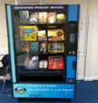
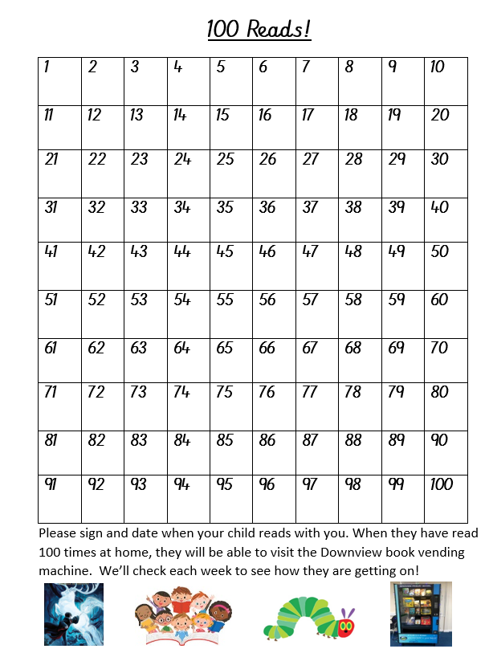
Reading…
In Key Stage 2 encourage your child to bring their Accelerated Reader book home every day so that you can read together.
Try to read at home every day. Find a quiet time, and try to give the book your full attention for 10-15 minutes!
Sign their 100 square when you hear them read. 100 reads at home means a trip to the vending machine to choose a new book to take home!
Make it fun- Library visits, bedtime story, even an audiobook!

Slide 8


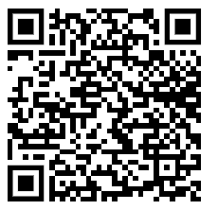
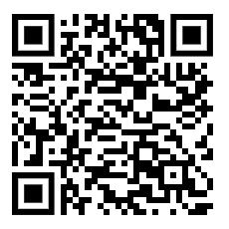
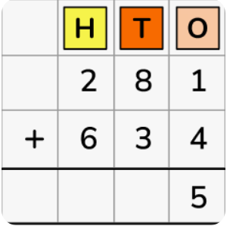
Maths – Y3 focus includes…
Recognise the place value of each digit in a 3-digit number (100s, 10s, 1s)
Add, subtract, compare and order fractions
Add and subtract numbers mentally, including:
Three-digit number and 1s, 10s and 100s
Add and subtract numbers with up to 3 digits
Find 10 or 100 more or less than a given number
Compare and order numbers up to 1,000
Solve number problems and practical problems
Recall and use multiplication and division facts for the 3, 4 and 8 multiplication tables
Count in multiples of 4, 8, 50 and 100
Add and subtract amounts of money to give change, using both £ and p in practical contexts
Tell and write the time from an analogue clock, including using roman numerals from I to XII, and 12-hour and 24-hour clocks
Lengths (m/cm/mm); mass (kg/g); volume/capacity (l/ml)
Measure the perimeter of simple 2-D shapes
Still using skills such as estimation, problem solving, checking calculations,
measuring and comparing!
Android
Apple

Slide 9
PE Days - Reminder
Hazel Class - Wednesday gymnastics and Thursday outside.
Laurel Class – Monday gymnastics and Friday outside.
Holly Class – Wednesday gymnastics and Friday outside.

Slide 10
Any Questions?
Our doors are always open!
We are here to help and support you all as families and want only the very best year for your children!

Slide 11





Reading… other useful information
‘The Reader Teacher’ - A great place to find books to read. https://www.thereaderteacher.com/
Come along to our book fair 15th -22nd October after school in the hall! There will be books to suit all budgets, so you can start you Christmas shopping early!
Visit the library in town –it’s free and you can borrow up to 20 books at a time!
READ, READ, READ anything, anytime , anywhere as much as you can! Comics, picture books, menus – literally anything is reading!
Check out our website ‘Helping your child to read at home’ for extra tips and support.

