Slide 1
















Welcome to Year 1
Meet the teachers

Slide 2





Our school day and attendance
The school gates open at 8:35am and we will open the Year 1 gates at 8:40am.
We kindly ask that unless its raining, you stay behind the blue gates in the mornings.
Please try to arrive at school on time as learning starts as soon as the children arrive with their morning activities.
The school day finishes at 3:20pm and we kindly ask that children do not play with any of the equipment outside the classrooms or on the playground after school.
If your child is ill, has an appointment or you are going on holiday, please let the office know and they will pass this on to us.

Slide 3
Admin Bits
  Please name all items of clothing.
  Please name water bottles. These should contain only water and please where possible, avoid putting them in book bags.
  In Year 1, children are provided with a fruit or vegetable snack everyday. If you would like your child to bring their own fruit or vegetable snack in, please make sure it is in a named pot.
  We kindly ask that children do not bring in toys from home.

Slide 4

Purple Mash
  Login information in the back of reading records
  PurpleMash To-Do’s are set for the children’s computing lessons so please don’t do these at home.

Slide 5



PE
PE kits should be:
  Downview navy PE top or a plain white T-Shirt (without buttons)
  Blue or black shorts
  Trainers or plimsolls
  Blue or black jogging bottoms or leggings and a blue or black sweatshirt (for outside use when cold).
Children are not allowed to wear jogging bottoms for indoor lessons due to safety reasons but may bring shorts to change into if the weather is cold (Leggings are permitted). Hooded sweatshirts are not allowed for PE as these can be a safety hazard.
No earrings or jewellery on PE days please. If earrings can’t be removed they will need micropore tape on them.
Indoor- Monday
Outdoor- Wednesday
Indoor- Thursday
Outdoor- Wednesday
Indoor- Friday
Outdoor- Tuesday

Slide 6


Birthdays
Like in Reception, your child is able to come to school on their birthday dressed in their own clothes.
If your child’s birthday falls on the weekend or in one of the holidays, they can pick a day around their birthday to come in in their own clothes instead!

Slide 7

Reading in Year 1
Book Levels:
Parents and carers are encouraged to listen to their child read everyday.
Children will change their reading books when ready; we encourage children to read their books at least 2-3 times to develop their comprehension skills and their fluency.
End of Year R expectation
End of Year 1 expectation
Free reader

Slide 8
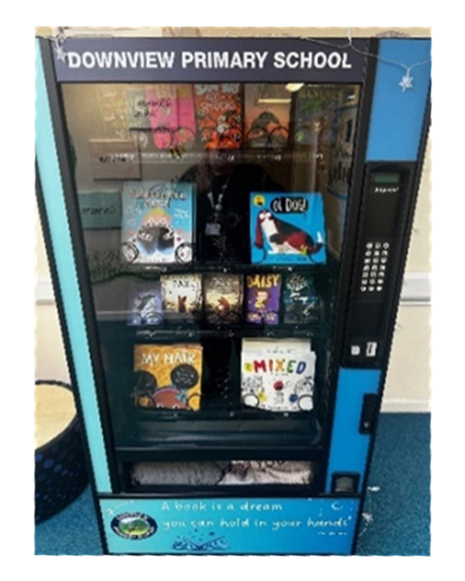
Reading in Year 1
Please don’t forget to date and initial the 100 grids in your child’s reading record.
For every 20 reads your child does at home, they can pick a treat from our Remarkable Readers box!
Then when they achieve 100 readers they can get a golden token and choose a book from our vending machine.

Slide 9

Year 1 Phonics Screening Check
Will take place the week beginning Monday 14th June 2027.
The screener is designed to give teachers and parents information on how your child is progressing in phonics. It will help to identify whether your child needs additional support at this stage so that they do not fall behind in this vital early reading skill.

Slide 10

Homework
READ, READ, READ! The main focus for children in Year 1 is to read at home.
The spellings the children are learning each half term will be uploaded to the Year 1 page on the school website if you would like to practise these with your child at home.
Multiple

Slide 11
Looking Ahead
Parents Evening: Wednesday 21st October and Thursday 22nd October
Year 1 Christmas Show: Thursday 10th December (pm- time tbc)
Visit from the RepTylers: Spring Term date tbc
Visit to Arundel Castle: Summer Term date tbc

Slide 12
Thank you!

