Slide 1
















Welcome to Year 1
Meet the teachers

Slide 2
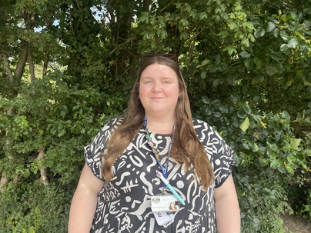
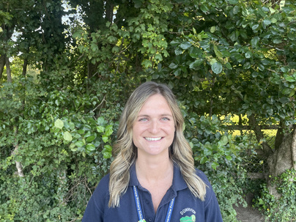
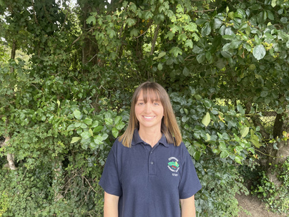
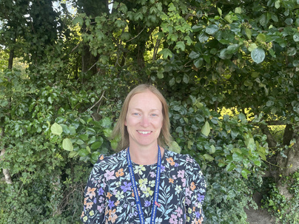



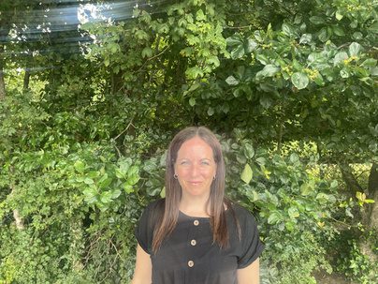
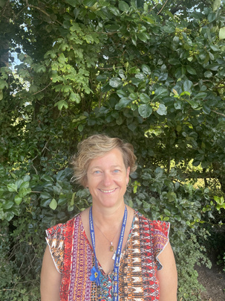
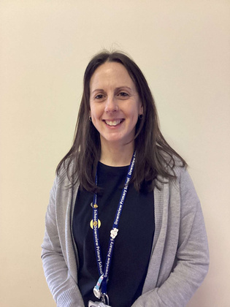
Our Team
Miss Rushworth
Miss McLaughlin
Miss Webb
Mon-Wed
Mrs Docherty
Wed-Fri
Mrs Stemp
Mrs Stimpson
Mrs Sherlock
Wed

Slide 3





Our school day and attendance
The school gates open at 8:35am and we will open the Year 1 gates at 8:40am.
We kindly ask that unless its raining, you stay behind the blue gates in the mornings.
Please try to arrive at school on time as learning starts as soon as the children arrive with their morning activities.
The school day finishes at 3:20pm and we will open the blue gates before this so that you can come under the blue shelter at pick up time.
If your child is ill, has an appointment or you are going on holiday, please let the office know and they will pass this on to us.

Slide 4
Admin Bits
  Please name all items of clothing.
  Please name water bottles. These should contain only water and please, where possible, avoid putting them in book bags.
  In Year 1 children are provided with a fruit or vegetable snack everyday. If you would like your child to bring their own fruit or vegetable snack in, please make sure it is in a named pot.
  We kindly ask that children do not bring in toys from home.

Slide 5

PE Days and Kit
PE days for Autumn 1:
Apple: Wednesday (outdoor) and Friday (indoor)
Peach: Wednesday (indoor) and Friday (outdoor)
Pear: Wednesday (indoor) and Friday (outdoor)
Please remember to send your child into school on PE days in the correct kit.
  T- shirt, round necked, white
  T-shirt, round necked, navy logo
  Shorts, blue or black, preferably black must be worn for indoor PE
  Trainers will be needed for outdoor PE
  Plain navy or black jogging bottoms for outdoor PE
  Plain navy or black sweatshirt or school cardigan/jumper can be worn for PE
  No football attire with a logo of any club (supported or played for)
  Earrings must be taken out for PE and hair tied up.

Slide 6


Birthdays
Like in Reception, your child is able to come to school on their birthday dressed in their own clothes.
If your child’s birthday falls on the weekend or in one of the holidays, they can pick a day around their birthday to come in in their own clothes instead!
On your child’s birthday, they can bring in something to show their class for ‘Birthday Show and Tell’.
This is the only time in Year 1 that we do show and tell.

Slide 7

Reading in Year 1
Book Levels:
Parents and carers are encouraged to listen to their child read everyday.
Children will change their reading books when ready; we encourage children to read their books at least 2-3 times to develop their comprehension skills and their fluency.
Children will also bring home a text from our Book Boxes which we will change weekly.
These are books for you to share with your child and enjoy together!
End of Year 1 expectation
Free reader

Slide 8
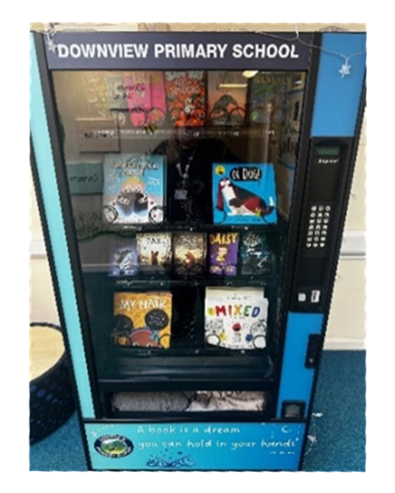
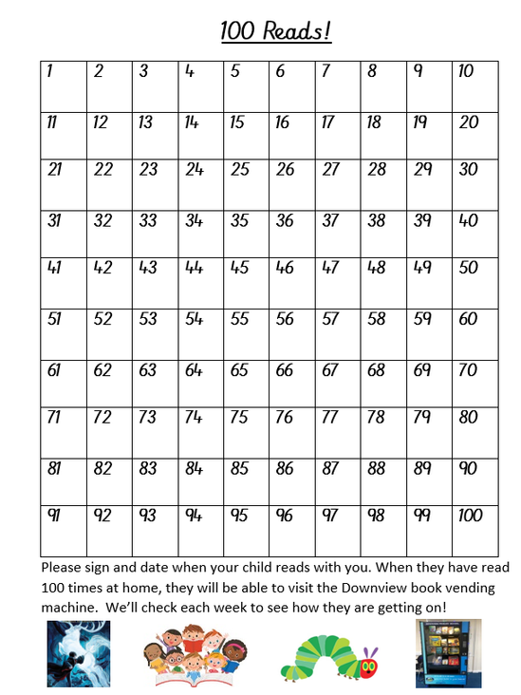
Reading in Year 1
Please don’t forget to date and initial the 100 grids in your child’s reading record.
For every 20 reads your child does at home, they can pick a treat from our Rainbow Readers box!
Then when they achieve 100 readers they can get a golden token from Mrs Purkis and choose a book from our vending machine.

Slide 9

Year 1 Phonics Screening Check
Will take place the week beginning Monday 8th June 2026.
The screener is designed to give teachers and parents information on how your child is progressing in phonics.
Phonics Presentation: Tuesday 30th September 2:30pm in the hall (letter to follow soon).

Slide 10
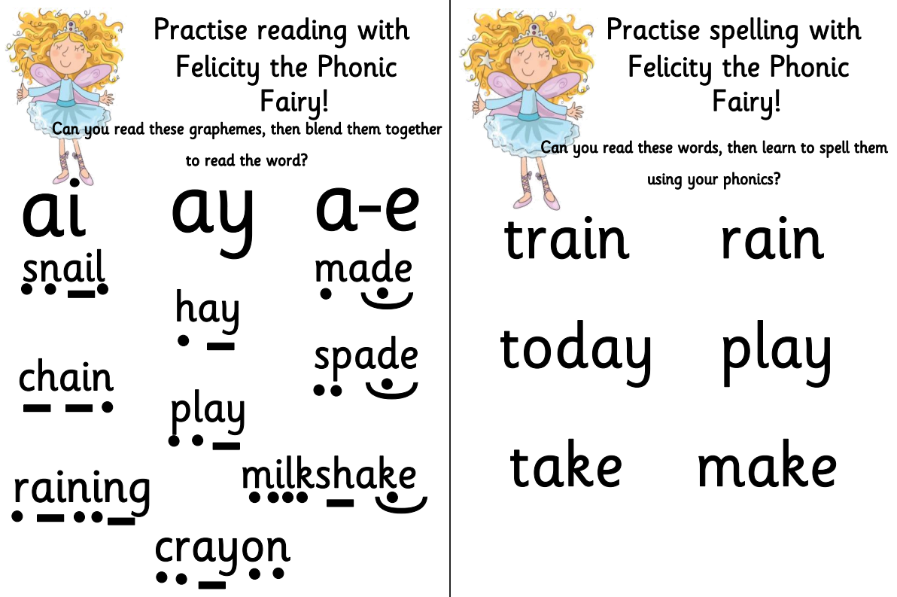
Homework
Phonics Homework sheets will come home starting next week when we learn a new sound.
READ, READ, READ! The main focus for children in Year 1 is to read at home.
The spellings the children are learning each half term will be uploaded to the Year 1 page on the school website if you would like to practise these with your child at home.
We will also upload our Topic Webs half termly onto the website so you can see what your child will be learning at school.
From next half term, we will also upload some suggested activities you could do with your child at home to support their learning.

Slide 11
Looking Ahead
European Day of Languages: Friday 26th September
Parents Evening: Wednesday 22nd October and Thursday 23rd October
Year 1 Christmas Show: Tuesday 9th December
Visit from the RepTylers: Spring Term date tbc
Visit to Arundel Castle: Summer Term date tbc

Slide 12
Thank you!

