Slide 1

Downview Primary School
Year 5
2025 - 2026

Slide 2
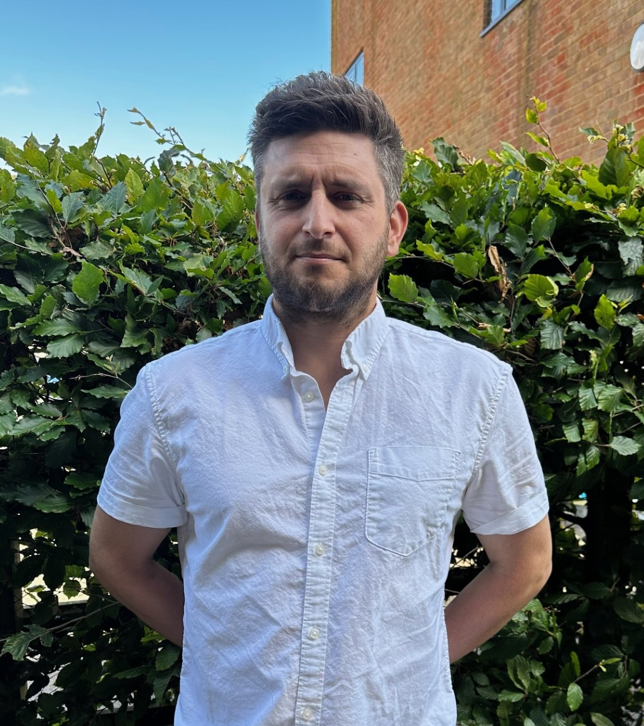
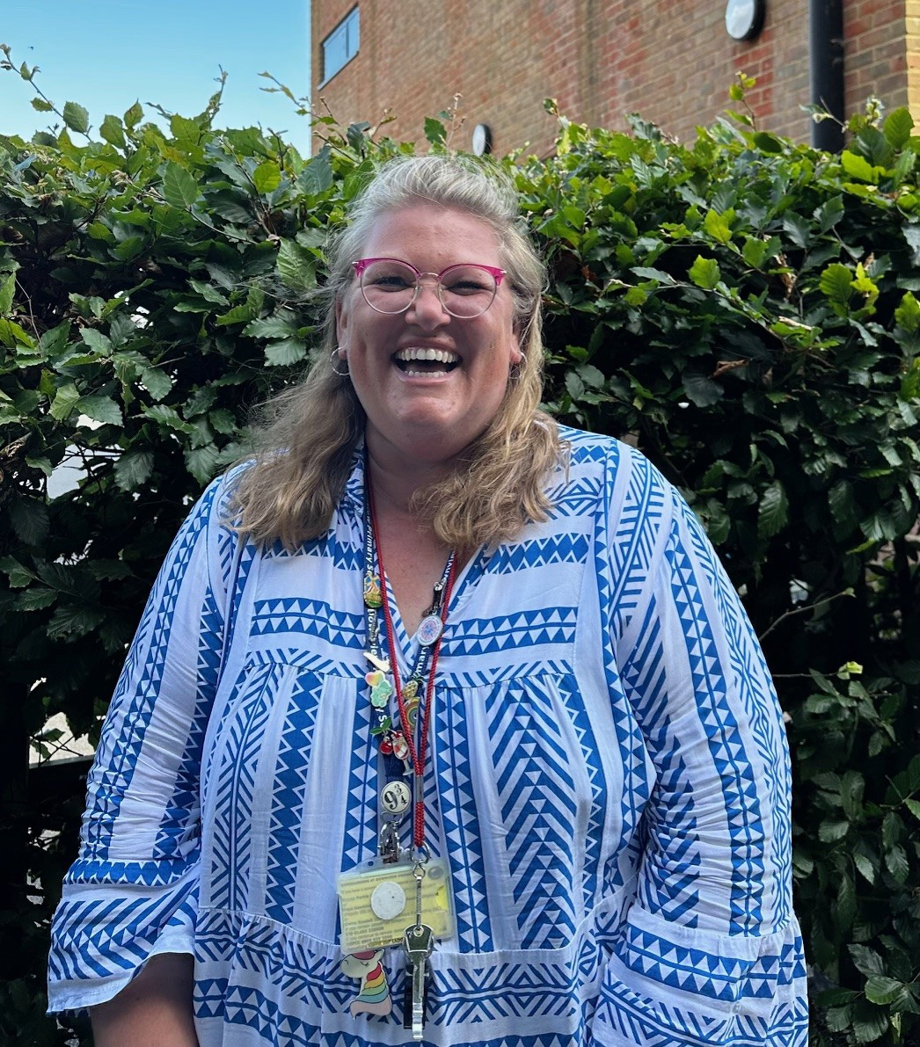
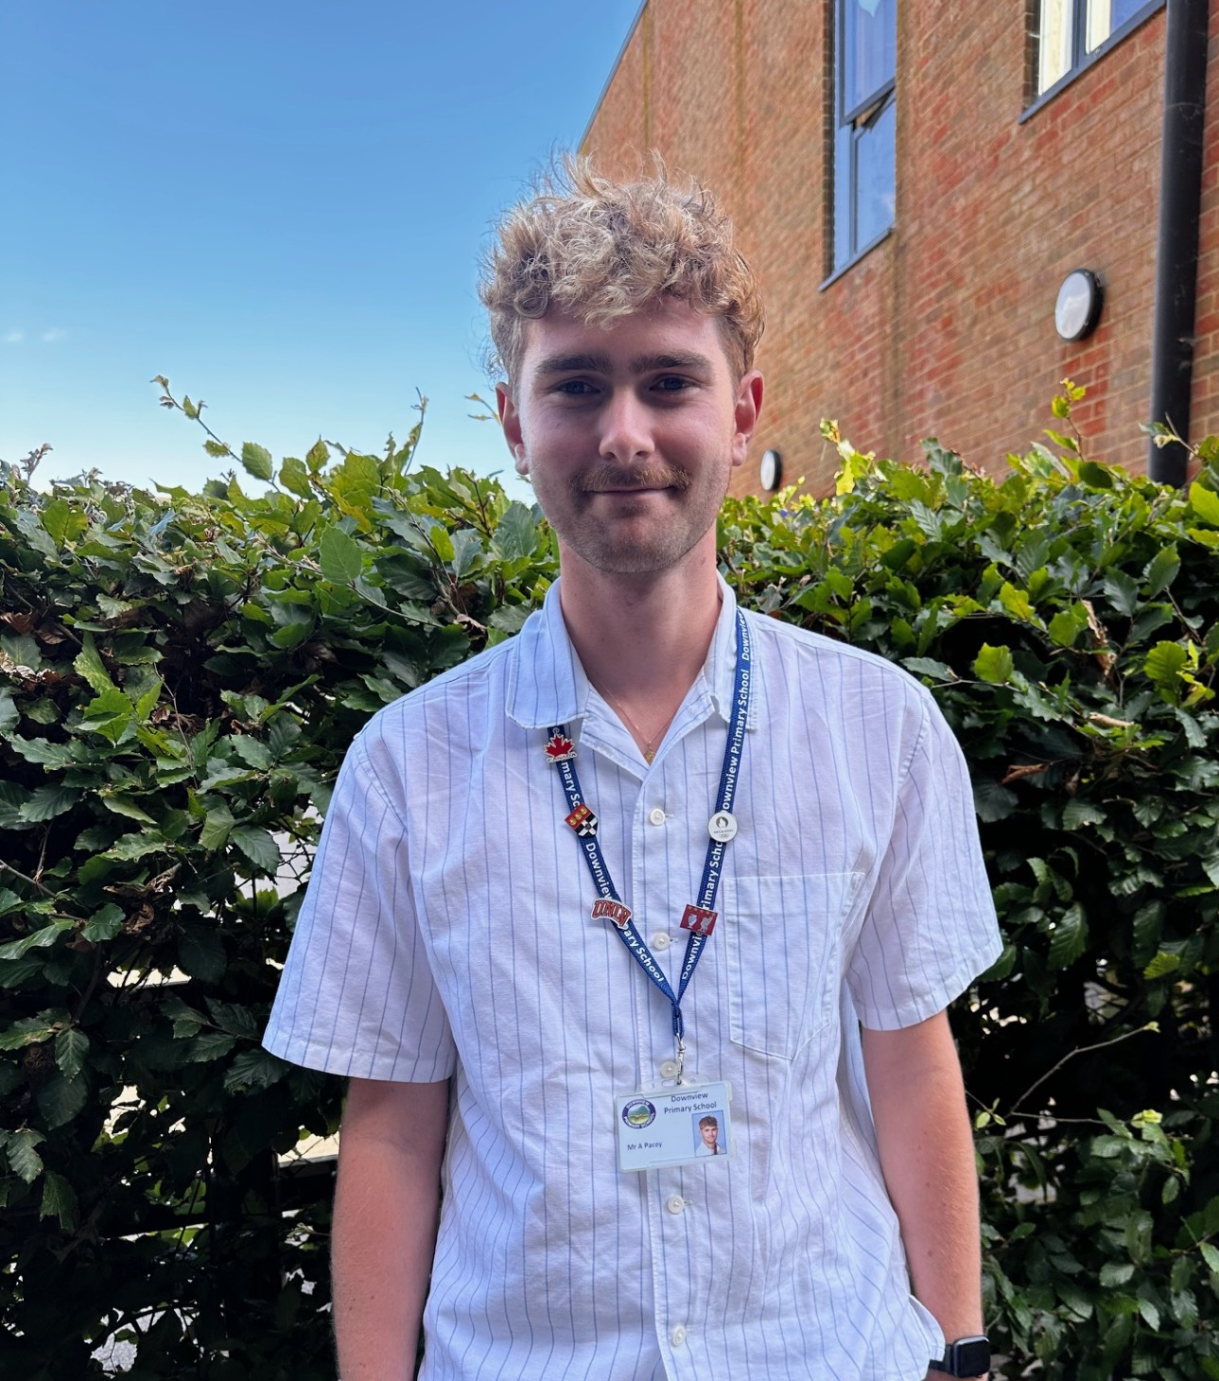
The Year 5 team:
Redwood: Mr Norris
Sycamore: Mrs Gapper
Maple: Mr Pacey
Teaching assistants:
Mrs Miller, Mrs Bates, Mrs McCarthy
Contact us: Year5admin@downviewprimary.co.uk

Slide 3
The school day:
8.40 into class – Morning work (Spellings, x tables and reading)
Two morning sessions English and Maths
(separated by a 20 minute break and assembly on Wednesday and Thursday)
12.00 – 1.00 LUNCH
Reading time straight after lunch each day
Science, PE and foundation subjects are often taught in the afternoon
3.20 Home time

Slide 4



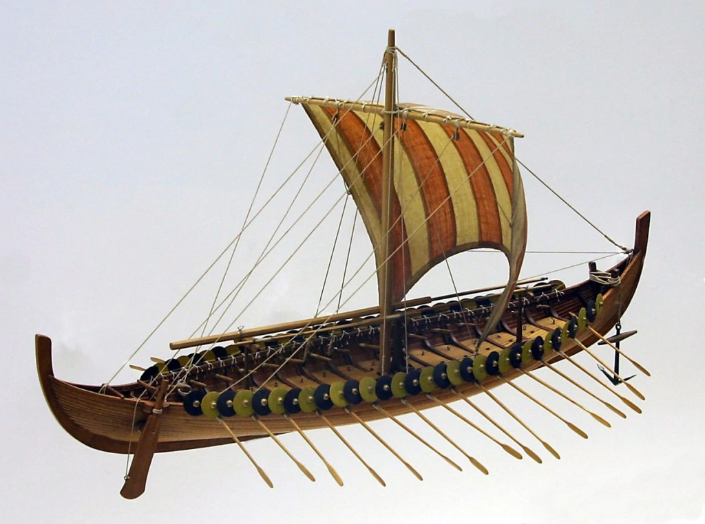
Year 5 Curriculum:
History
Anglo-saxons
Greeks
Geography
Deserts
Alps
Science
Forces
Earth & Space
Art and DT
Mixed media portraits
Oceans
Living things
Materials
Sculptures
Anglo-saxon boats
Each term, there will be a more detailed topic web available on our school website https://www.downviewprimary.co.uk/

Slide 5
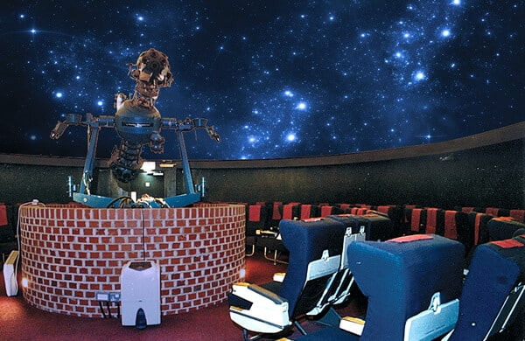
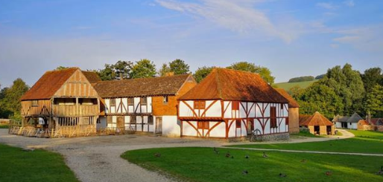
Year 5 visits:
Autumn Term: Planetarium
(Supporting science topic – Earth and Space)
Autumn Term: Weald and Downland Museum
(supporting history topic – Anglo Saxons)

Slide 6
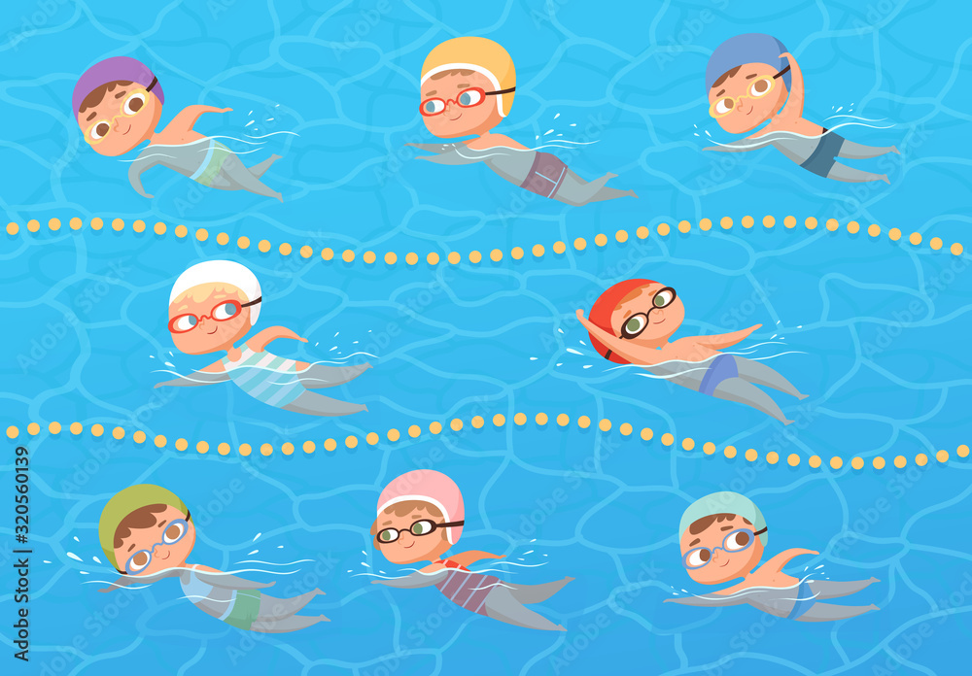
Swimming
WE START THIS FRIDAY
Friday 12th Sept – Friday 12th Dec
As the weather changes, all children must bring a warm waterproof coat.
Children should come costume ready – remember to pack underwear with a towel. Please come to school in PE kit on Fridays to help with changing afterwards.
Goggles strongly recommended.
PE days this half term:
All three classes: Thursday and Friday (swimming).
Children come to school in PE kits please (See uniform requirement on website)
Long hair to be tied up and no jewellery to be worn

Slide 7









Year 5 English – Teaching through a text

Slide 8

Yr 5 Homework – this will usually go hand in hand with the previous week’s learning
1. Short writing task – there will be one language or grammar focus to include
(If children have enjoyed a really special experience or have just done something they would like to write about, you are welcome to make that the focus that week instead of the task that has been set)
2. Maths homework – set on Mymaths (Children’s log ins are stuck into their reading records and homework folders)
(if you are unable to access a laptop/tablet/phone, please let us know)
3. Spelling practice – Autumn 1 we revise last year’s Yr 4 key words before moving onto Yr 5
(Children will be tested weekly - each Friday on 10 spellings they have practiced that week)
*If your child has been assigned a Lexia account – please log on at home instead of spelling practice in Autumn 1
4. Reading – aim for 3x weekly. Adults/older siblings, please sign the 100sq in the front of reading records
50 = Time to read token, 100 = Brand new book of choice from the vending machine.
Homework is set on a MONDAY and is expected back in the following Monday.
Effort is always celebrated and rewarded.

Slide 9
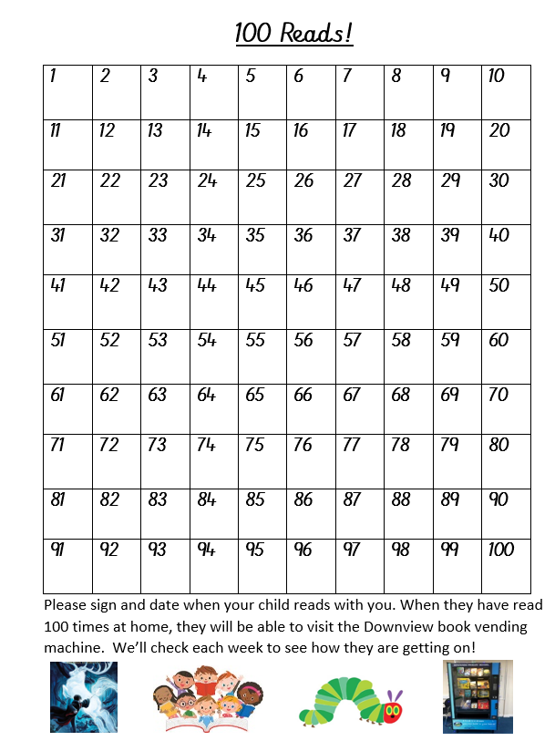
Help your child to reach 100 reads!
Please sign their 100 square every time you hear them read. If you need a pen, please ask.
We will regularly check their progress with this.

Slide 10















Reading at Downview
We work hard with all our children to support them to read with confidence and enjoyment, and become lifelong readers.
We need your help!

Slide 11
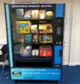
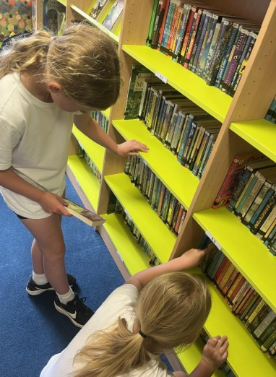
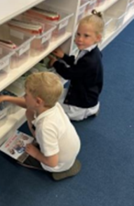
Reading at home
In Key Stage 2 encourage your child to bring their Accelerated Reader book home every day so that you can read together.
Try to read at home every day, a minimum of 3 times a week is essential for good progress. Find a quiet time, leave phones/tablets in a different room to give the book your full attention for 10-15 minutes!
Sign their 100 square when you hear them read. 100 reads at home means a trip to the vending machine to choose a new book to take home!
Make reading part of your routine. They will love it even more if use an accent, whisper or sing, have fun with the story, even if you’ve read several times before! Children love being read to from Reception to Year 6 and beyond! Hearing someone else read aloud is an important part of learning to read.

Slide 12
Other useful information:
Use ‘The Reader Teacher’ . A great place to find books your child will love to read.
https://www.thereaderteacher.com/
Visit the library in town –it’s free and you can borrow up to 20 books at a time
READ, READ, READ anything, anytime, anywhere as much as you can!
Check out our website ‘Helping your child to read at home’ for extra tips and support.

Slide 13
Thank you for coming – this powerpoint will be on the Year 5 page of the school website.

