Slide 1

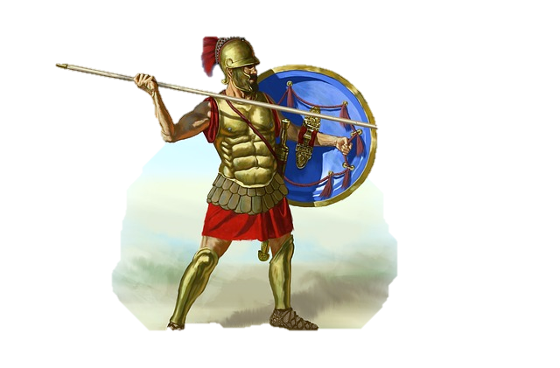





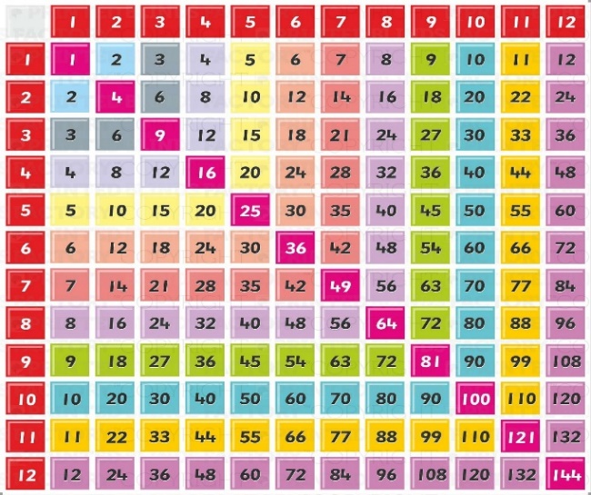


Welcome to Year 4

Slide 2


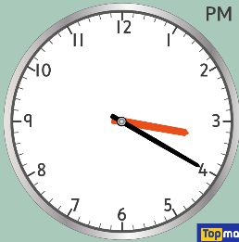
Timings and attendance
School begins at 8:40am. Please try to arrive at school on time as learning starts as soon as children arrive with spelling and grammar.
The school day ends at 3:20pm. In Year 4, children are allowed to leave the classroom on their own but please could you make contact with the office to let them know.
If you have any issues concerning your children please do email us or come and see us at the end of the day.
Please try to keep attendance high so children do not miss important learning.

Slide 3


Autumn 1 – From darkness to light
Living things and their habitats
Rainforests
In the French classroom
The Internet
Place value, addition and subtraction
Painting and mixed media
Abba
Dance and
co-orination and balance

Slide 4


Autumn 2 – Swords and sandals
Romans
Animals including humans
Drawing
Audio production
World religion
Measurement, multiplication and division
Dance and Jumping and landing
Woodland

Slide 5

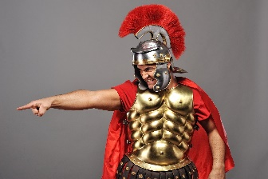
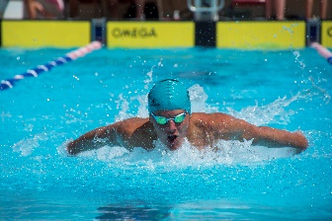
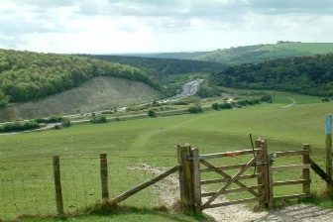

Looking Ahead
Swimming in the Spring Term – 10 lessons
Rainbow Theatre performance and Roman Day
10th November
Summer Term
Trip to a River
Multiplication Tables Assessment
1st June

Slide 6
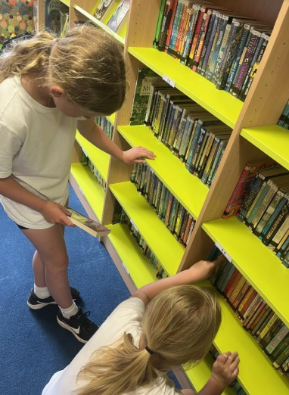
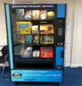
Reading at home
Children in Year 4 will read books on Accelerated Reader.
After every AR book they read, they will complete a quiz in school to monitor their progress. Your child’s reading level will be monitored to ensure they have a good understanding of what they are reading, and to track their progress.
Encourage your child to bring their Accelerated Reader book home every day so that you can read together.
Try to read at home every day, a minimum of 3 times a week is essential for good progress. Find a quiet time, leave phones/tablets in a different room to give the book your full attention for 10-15 minutes!
Sign their 100 square when you hear them read. Only one sign per day. 100 reads at home means a trip to the vending machine to choose a new book to take home!
There will be a small reward for the children when they reach 25 reads, 50 reads, 75 reads and 100 reads.

Slide 7



Homework
Homework will be given out every Monday and will be stuck in to your child’s reading record.
Practise spellings
Children will be given 5 spellings to learn at home which they will also learn in school with an informal spelling test on Fridays. To begin the year they will recap some of the Year 3 words.
2) Practise times tables
TT Rockstars – your child’s log in and password will be in their reading record.
3) Reading
We would be grateful if you encourage your child to read at home regularly. Reading independently is beneficial but it is great if children can read to an adult at home.
There is no punishment for not completing homework but any children who do complete any part of the homework will be rewarded with house points, stickers, raffle tickets and reading rewards.

Slide 8



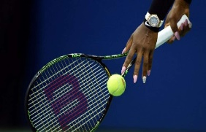
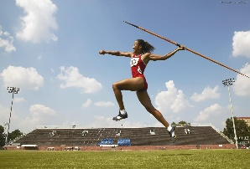
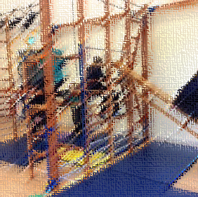

PE
We will be teaching PE from the RealJasmine PE scheme which focuses on teaching skills that can be used in lots of different areas of PE. We will also be having PE lessons that focus on a particular sport or activity – some of those will be gymnastics, dance, tennis, hockey, athletics, cricket and rounders.
As in Year 3, children will be coming to school in PE kit for PE days.
Autumn 1 – Elm Monday & Tuesday
Oak Tuesday & Thursday
Beech Monday & Thursday
It is important to wear PE kit that is in keeping with the school PE uniform

Slide 9

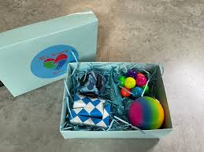
Please can we kindly ask that your child does not bring in toys.
Some children need items to support them in their learning and these will either be provided by the school or by you.

Slide 10
Contact and information
We will contact you with information, like PE days and trips, through parentmail.
We will also keep the school website page for Year 4 updated (the topic web for the 1st half of Autumn Term is uploaded now)
If you have any queries, please email us or speak with us at the end of the school day.
You can email the school who will pass on information or directly to the year 4 email:
office@downviewprimary.co.uk
Year4admin@downviewprimary.co.uk
If you email about absence or appointments, please could you email the office.

