Slide 1


Year 6 SATs
11th – 14th May 2026

Slide 2
What & When
SATs are the Standardised Assessment Tests that are given to children at the end of Key Stage 2.
The SATs take place over four days, starting on Monday 11th May ending on Thursday 14th May.
The SATs papers consist of:
  Grammar, punctuation and spelling (paper 1: GPS) – Monday 11th May
  Grammar, punctuation and spelling (paper 2: Spelling) – Monday 11th May
  Reading – Tuesday 12th May
  Maths (paper 1: Arithmetic) – Wednesday 13th May
  Maths (paper 2: Reasoning) – Wednesday 13th May
  Maths (paper 3: Reasoning) – Thursday 14th May

Slide 3
Grammar, Punctuation and Spelling: Monday 11th May
Two papers.
Paper 1 focuses on all three elements (grammar, punctuation and spelling or GPS). The paper lasts for 45 minutes.
Paper 2 consists of a spelling test only. It should take approximately 15 minutes, although this is not a set amount of time (pupils should be given as much time as they need to complete the test).
This test focuses on:
Grammatical terms/ word classes;
Functions of sentences;
Combining words, phrases and clauses;
Verb forms, tenses and consistency;
Punctuation;
Vocabulary;
Standard English

Slide 4



Grammar, Punctuation and Spelling: Monday 11th May

Slide 5


Grammar, Punctuation and Spelling: Monday 11th May

Slide 6
Reading: Tuesday 12th May
There is one reading test that lasts for 60 minutes.
The test is designed to measure if the children’s comprehension of age-appropriate reading material meets the national standard. There are three different set texts for children to read. These could be any combination of non-fiction, fiction and/ or poetry.
The test covers the following areas:
Meaning of words in context;
Retrieve and record information/ identify key details from fiction and non-fiction;
Summarise main ideas from more than one paragraph;
Make inferences from the text/ explain and justify inferences with evidence from the text;
Predict what might happen from details stated and implied;
Identify/ explain how information/ narrative content is related and contributes to meaning as a whole;
Make comparisons within the text.

Slide 7




Reading: Tuesday 12th May

Slide 8
Reading: Tuesday 12th May
Since the current testing formation for the SATs began in 2016, there has been a tendency for three types of questions to be the most popular.
In the 2025 Reading SATs paper,
12% of marks could be gained from answering questions involving giving and explaining the meaning of words in context;
30% of marks could be gained from answering questions involving retrieving and recording information or identifying key details from a text;
48% of marks could be gained from answering questions involving making inferences from a text and justifying inferences with text evidence.

Slide 9
Maths: Wednesday 13th May and Thursday 14th May
The maths assessments consist of three tests.
Paper 1: Arithmetic (30 minutes) – Wednesday 13th May
Paper 2: Reasoning (40 minutes) – Wednesday 13th May
Paper 3: Reasoning (40 minutes) – Thursday 14th May

Slide 10



Maths: Wednesday 13th May and Thursday 14th May
The maths arithmetic paper has a total of 40 marks and lasts for 30 minutes.
The test covers the four operations (addition, subtraction, multiplication, division including order of operations requiring BODMAS), percentages of amounts and calculating with decimals and fractions.

Slide 11
Maths: Wednesday 13th May and Thursday 14th May
Reasoning Papers
These tests have a total of 35 marks each and lasts for 40 minutes each.
These papers require children to demonstrate their mathematical knowledge and skills, as well as their ability to solve problems and their mathematical reasoning. They cover a wide range of mathematical topics from key stage 2 including,
Number and place value (including Roman numerals);
The four operations;
Geometry (properties of shape, position and direction);
Statistics;
Measurement (length, perimeter, mass, volume, time, money);
Algebra;
Ratio and proportion;
Fractions, decimals and percentages.

Slide 12



Maths: Wednesday 13th May and Thursday 14th May

Slide 13
The results
Tests are marked externally. Once marked, the tests will be given the following scores:
A raw score (total number of marks achieved for each paper)
A scaled score (see below)
After marking each test, the external marker will convert the raw score to a scaled score.
Scaled scores range from 80 to 120.
A scaled score of 100 or more shows the pupil is meeting the National Standard.
2025 Scale score (100):
Reading 28/50
Maths 58/110
GPS 35/70

Slide 14
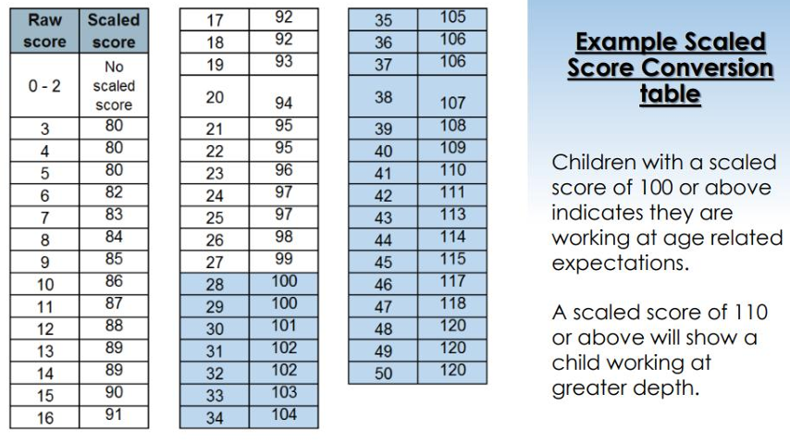
The results

Slide 15
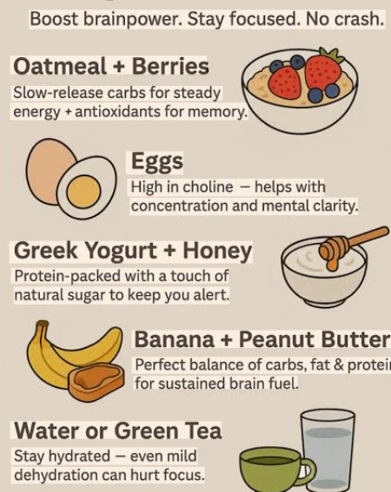

Top Tips!
Revision - little and often (use websites given out at parents evening)
Good sleep – better focus, memory and mood improves
Breakfast matters – Slow-release energy (breakfast club at school, 8.10am)
Keep hydrated!
Recognise that your child may feel a little more stressed than usual – be ready to support and encourage,

Slide 16

In reality, it’s just one or two papers lasting 30-60 minutes each day. You can’t emphasise enough the importance of keeping that in perspective. SATs don’t show the majority of your child’s achievements throughout the year. They won’t reflect how talented they are at Science, Geography, Art or PE, and they certainly won’t highlight positive personal characteristics such as kindness and integrity. Your child/children have numerous qualities and talents that a SATs paper could never judge.

Slide 17

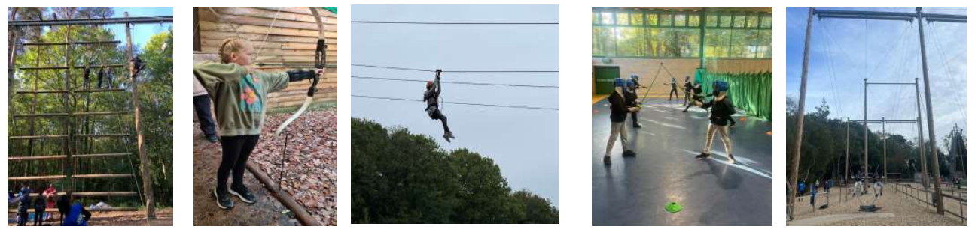
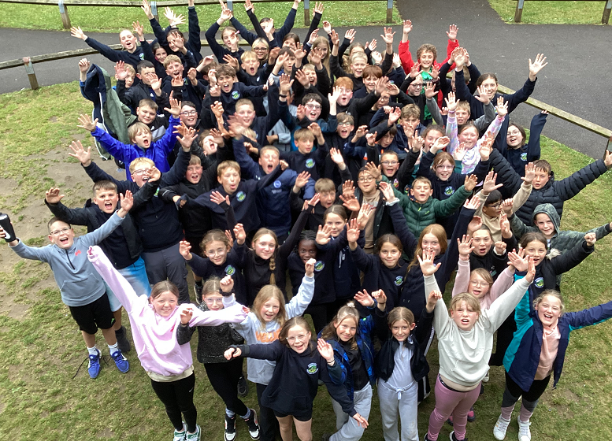
Marchants Hill Residential
3rd June to 5th June 2026

Slide 18
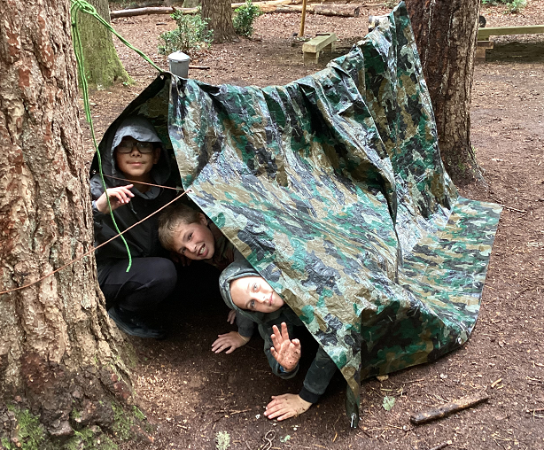
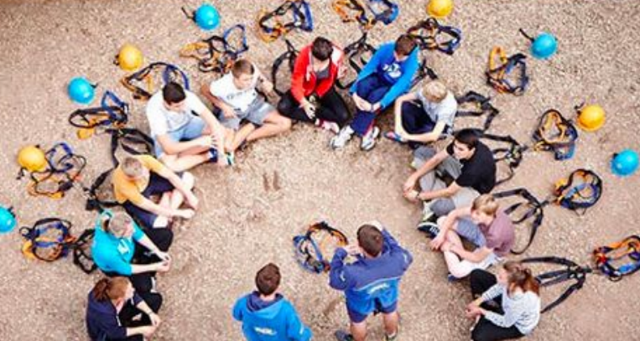
Why are you going?
Building independence
Building resilience
Building self confidence
Building team work skills
Shared Experience
Celebrate the end of Primary School
Creates Memories!

Slide 19

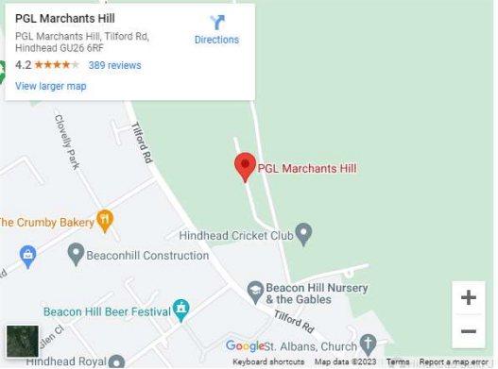
Where are we going?
Marchants Hill - Surrey
24 fantastic adventure activities to choose from
45 acres of grounds in an area of outstanding natural beauty
Lakes for watersports and stunning hiking opportunities

Slide 20
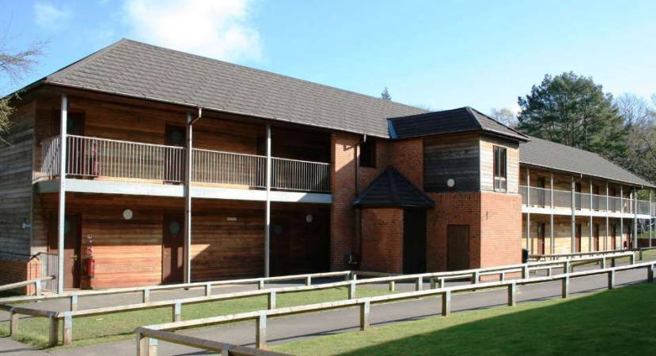
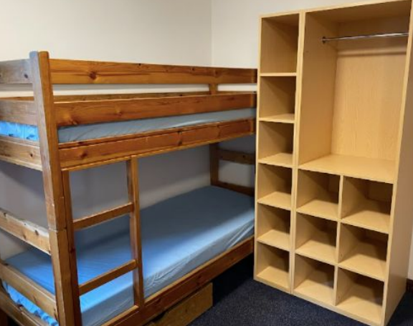
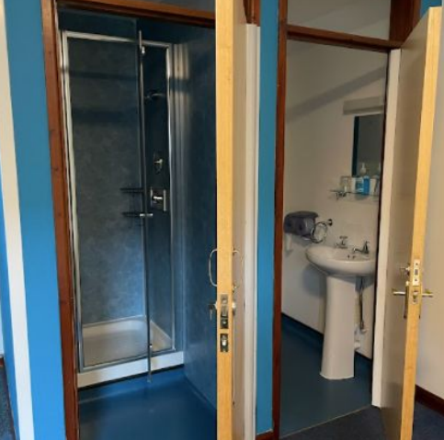
Accommodation
Children sleep in bunk beds in rooms of 4 or 6.
Every room has an ensuite toilet and shower which is
shared by the children in that room.
The teachers rooms are alongside the children’s rooms and so there is an adult close by 24 hours of the day.
Children will write down 4 names who they will like to stay in a room with. At least 1 of those names will be guarantied.
The children will find out who they are staying with on the day.

Slide 21
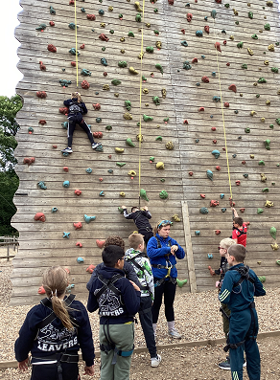
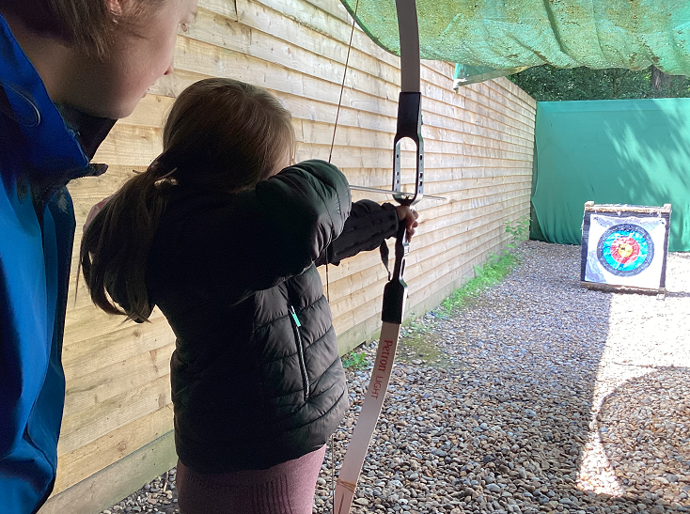
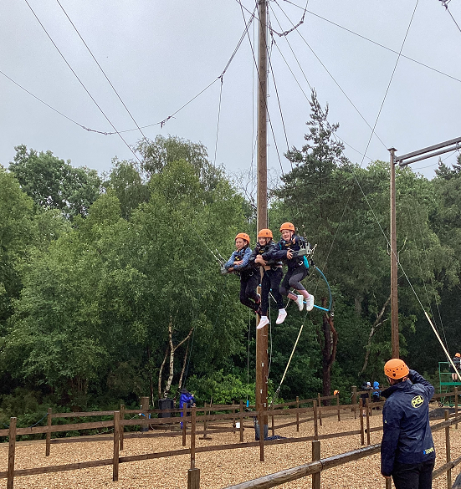
What will you be doing?
4 adventure activity sessions per day (all outside)
Eating three healthy meals a day
Evening entertainment
Sleeping really well at night!

Slide 22
Activities
All activity sessions are led by fully-trained PGL instructors
Safety is always the priority
At least one member of school staff will accompany each group.
Activities during the day include:
• Climbing
• Survivor
• Raft Building
• Orienteering
• Abseiling
• Giant Swing
• Archery
• Jacob’s Ladder
• Trapeze
• Problem Solving
• Challenge Course
• Rifle Shooting
• Laser Tag
• Zip Wire
Activities in the evening include:
Ambush
Boat Build
Campfire
Capture the Flag
Cluedo
Disco
Generation Game
Karaoke
Night Hike
Passport to the World
Quiz
Robot Wars
Splash
Starburst
Wacky Races

Slide 23

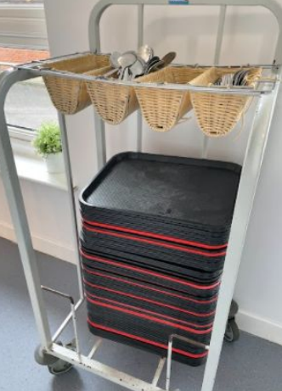
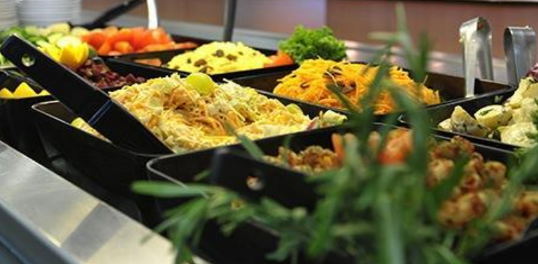
What will you eat?
3 nutritious, balanced meals per day
Self-service salad bar
Vegetarian option
Special diets catered for by prior arrangement

Slide 24
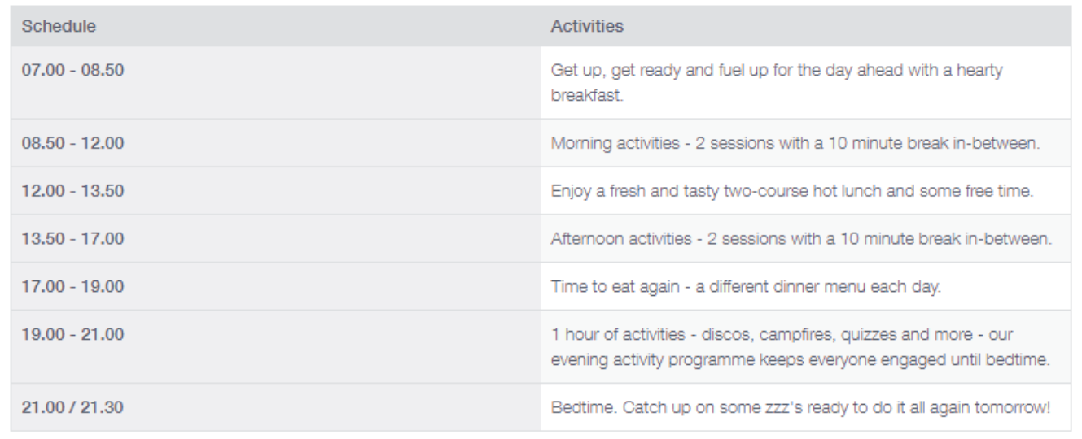
A typical day at Marchants Hill.

Slide 25
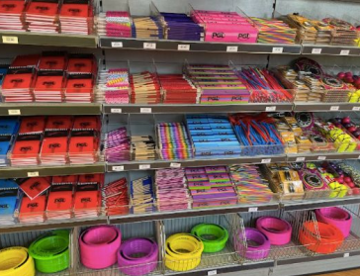
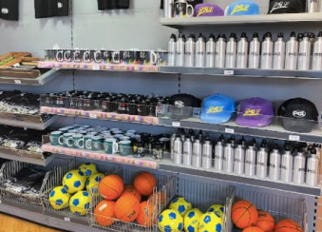
What can you buy with your pocket money?
They have a lovely gift shop
with souvenirs you can
buy to help you remember
your trip.
Each class will have an
allocated slot when they get
to visit the shop.
Please make sure the money is in a sealed, named envelope and given to a member of staff on the Wednesday morning.
We would appreciate the £5 in £1 coins.

Slide 26
Kit!
Your child must be able to carry their own bag.
· Packed lunch for the first day – in a disposable bag
· Reusable water bottle
· Sleeping Bag
· Pillow
· Nightwear
· Toiletries – soap, flannel, toothbrush and paste, shampoo, shower gel, brush, comb etc
· Towels
· Black bin liner for wet clothing/towels
· Old clothes – the children will get wet and possibly muddy.
Please send them with old clothes that you do not mind getting dirty and damaged
· Activity wear – trousers, shorts, t-shirts, sweatshirts, trainers.
Some of the activities require the children to have their arms or legs covered. Please ensure they have suitable clothing for this
· Underwear
· Waterproofs
· Torch
· Watch/Time device
· Camera (optional)
· Book to read at night or games (not electronic or precious)
· Teddy bear (optional)
· Sun hat
· Sun cream
Please remember that no electronic games, radios or mobile phones are permitted on the trip.

