Slide 1
Year Two
Welcome to
At Downview we grow and learn together every day.

Slide 2



Year Two classes:
Teachers:
Mrs Dewey and
Mrs Hellyer
Teachers:
Miss Weston and Mrs Hellyer
Teachers:
Mrs Kelly and
Mrs Oliver
Teaching Assistants:
Miss Amer Miss Kelly Mrs Plyman
Miss Muir Mrs Sherlock

Slide 3
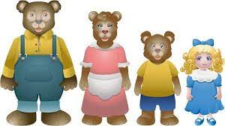

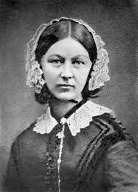
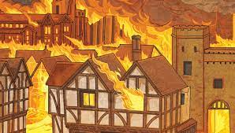
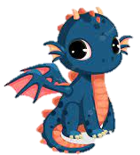
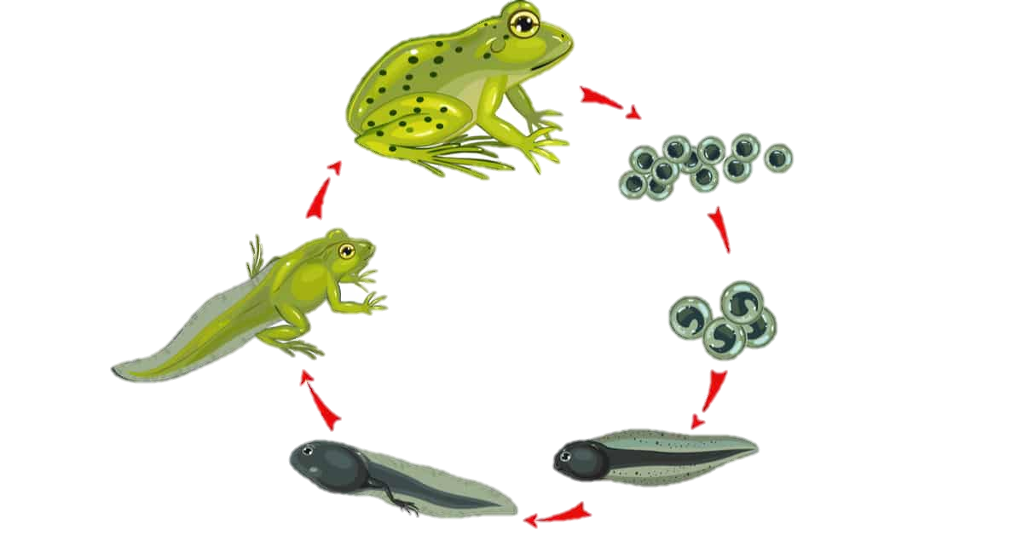
Our Topics This Year
A twist in a tale
Creation & Conservation
Bravery Vs Fear
Urban Metropolis
Fictional Worlds & Fantasy
Change & Relationships

Slide 4
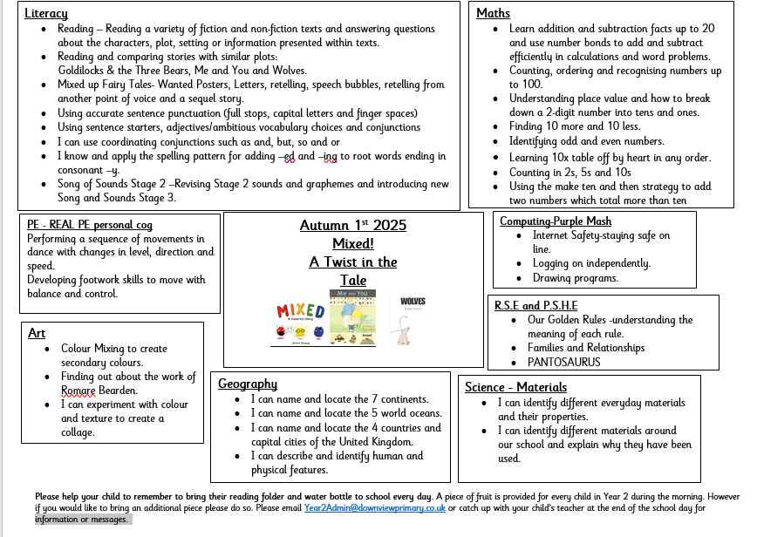

Slide 5

Reading
We continue our wonderful Downview reading journey in Year 2 with some lovely new stories in our English and Guided Reading lessons.
We would like the children to bring their new book bags into school every day as there will be many opportunities during the week for them to read their books.
Children will have opportunities to read during our daily literacy lessons as well as our daily guided reading and phonics sessions, as well as individually.
Books can be changed at the end of the day and we would ask that you come through the side entrance by the hall if you would like to change your child’s book with them. Please don’t change their book band level without speaking to their teacher first.

Slide 6
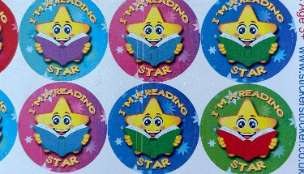
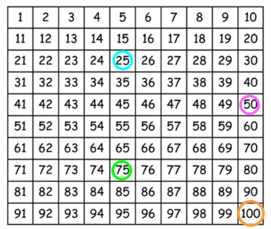
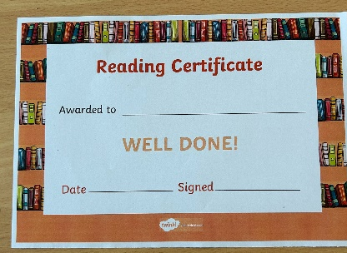
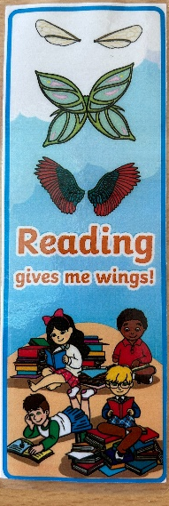
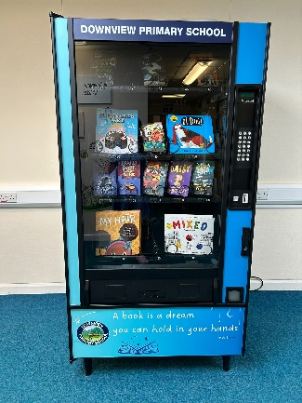
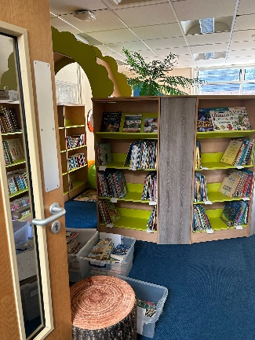
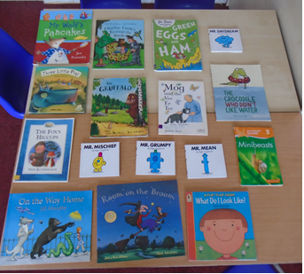

Reading
We continue to have an exciting reading initiative to encourage your child to read at home. To aid this please ensure that you sign the grid at the back of your child’s reading journal each time you read with them to help keep score. Each Friday we will count up the ticks. Once the children have read 25 times they will receive a special sticker, 50 times they will receive a book mark, 75 times will receive a certificate and finally once the children have read 100 times they will receive a gold token for a special book from the vending machine. After this the children will start again with the next level sticker, book mark certificate and another book token.
You will also find a grid at the beginning of your child’s reading record. This contains the books from their group‘s book box. The children will have the opportunity to change these books weekly. Once they have read a story from the book box please cross this off before they change it.

Slide 7
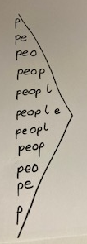
Spellings
We will start our spelling journey in Year 2 by practising and remembering our Year 1 spellings. We want to make sure these are secure before we move on.
In Year 2 we have 63 words to learn to spell!
We will practise spellings daily – sometimes using our phonics and sometimes looking at the Common Exception (Tricky) words.
We will send spellings home every few weeks. Please practice these at home to help your child remember them. You can make this fun using colourful pens, bath crayons or even chalk outside!
Try writing the spellings on each other’s back, or maybe put them up around the house.
Memory games can also help spelling skills so any game – online or practical where your child has to remember something visually will help too!

Slide 8


Slide 9
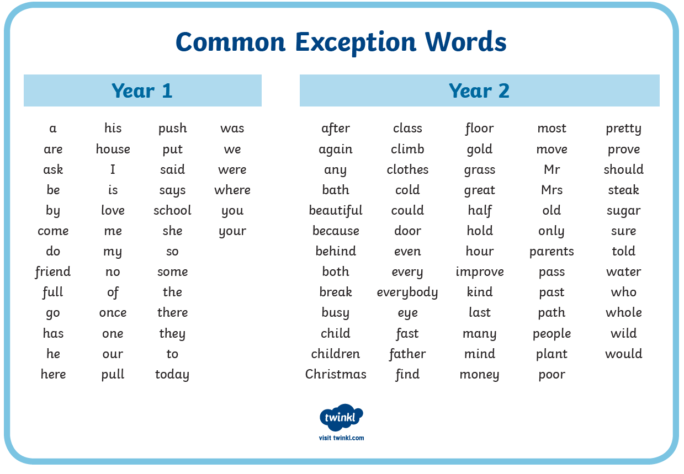

Slide 10
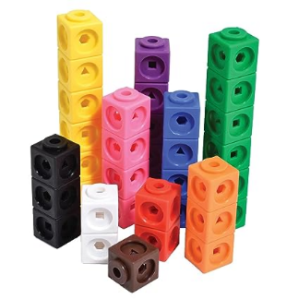
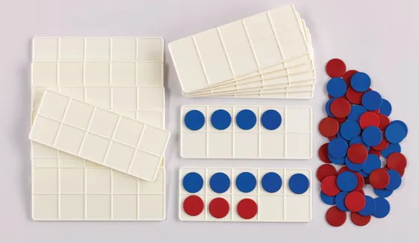
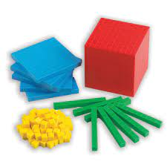
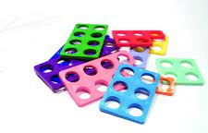

Maths
This year we will cover:
Place Value
Sequencing
Additional
Subtraction
Shape
Money
Multiplication
Division
Fractions
Time
Length
Height
Mass
Capacity
Temperature
Position & Direction
The children have logins for Numbots to practise their times tables.

Slide 11

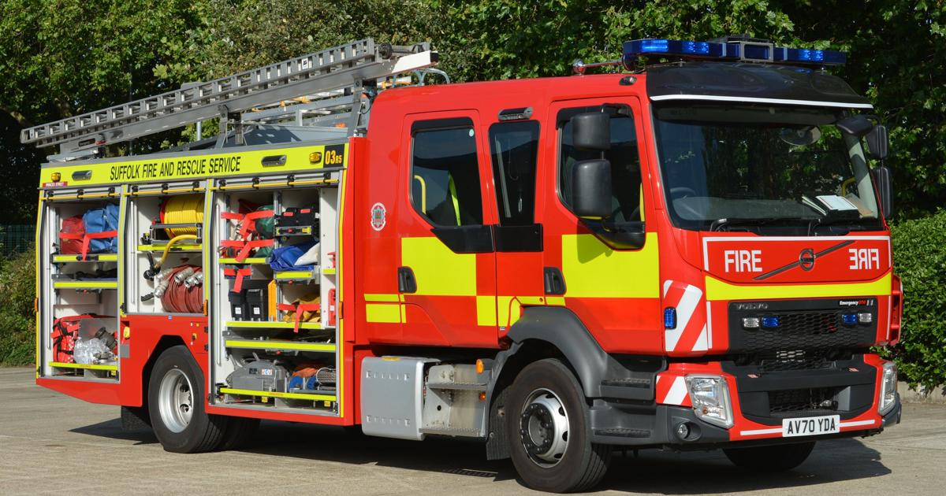
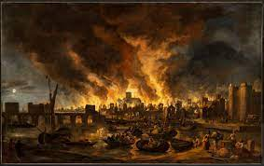

Trips & Exciting Events
European Day of Language – Friday 26th September 2025
Christingle –8th December 2025
Rainbow Theatre – 21st January 2026
Fire Service demonstrations – TBC
Dell Quay – End of April 28th ish!

Slide 12


Our P.E Days
Plum:
Indoor- Friday
Outdoor- Tuesday
Cherry:
Indoor- Monday
OutdoorTuesday
Apricot:
Indoor- Thursday
Outdoor- Tuesday
PE kits should be a plain white T-Shirt (without buttons), blue or black shorts, trainers or plimsolls, blue/black tracksuit/ jogging bottoms or leggings and a blue/black sweatshirt (for outside use when cold). Children are not allowed to wear jogging bottoms or leggings for indoor lessons due to safety reasons but may bring shorts to change into if the weather is cold. Hooded sweatshirts are not allowed for PE as these can be a safety hazard. No earrings or jewellery on PE days please.

Slide 13
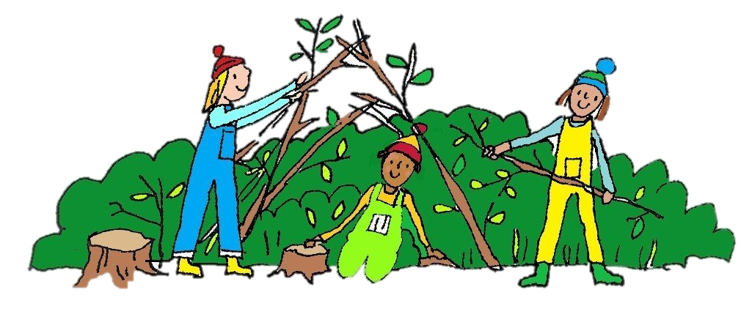
Woodland & Outdoor Learning
All the children will get the opportunity to learn in the woodland each half term. To support this please ensure your child has a spare pair of trainers/ wellington boots available for their woodland day. The children may need to come into school in woodland wear later on in the year.
Plum:
Friday
Apricot:
Friday
Cherry:
Friday

Slide 14
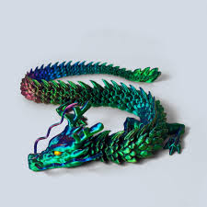
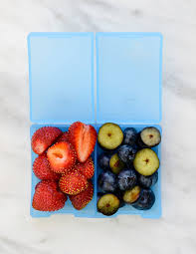
Other bits and bobs!
Toys
Please can we remind you that children are not allowed to bring in their toys to school. This is to save the heartache of losing them amongst other things! Our new Star of the Week treat is to bring in a few toys from home to share with their friends.
Fruit
Children can continue to bring in fruit from home for a morning snack at playtime. They are still provided with daily fruit by school. Just a reminder that fruit time snacks need to be fruit instead of crackers, cheese, biscuits etc unless your child has dietary needs that mean fruit is not appropriate. Please do speak to your child’s teacher if you have any concerns or queries over this.
Water
We know that some parents and children have been concerned about the rules we have in Year 2 around water bottles. We would like to reassure you that children continue to be able to drink at any point during the day except during learning inputs. We will continue to encourage children to drink regularly throughout the day. Please talk to your child’s teacher if you have any further concerns around this.

Slide 15
Other subjects
R.S.H.E- PANTS Rule and Pantosaurus
Science – Materials
Computing – Purple Mash and Numbots (Please support your child by practising logging into Numbots and Purple Mash at home.)
Geography – Would you like to live in a hot country or a cold country?
RE – Why do people give thanks?
Art – Colour mixing
Song of Sounds - Stage 3

Slide 16

Parent Helpers
If you would like to come into school and help support our children’s reading please let your child’s class teacher know so we can agree on a suitable time.
Thank you for all of your support!

Slide 17
Thank-you
Thank-you for taking the time to come and hear about our exciting year ahead in Year 2!
We are always here to answer any questions or listen to any concerns so please feel free to talk to us at the end of the school day or via Email if more convenient.

